Slide 1

DECOHUB

Slide 2
Members
Lin Htet Moe
Si Thu Myoe
Phonn Pyae Kyaw
Seth Paing Phyoe
Khant Myat Min
Kaung Mon Chit
Myat Kaung Khant

Slide 3
Objective
Visualize your real world room idea to 3D room
Design Your Custom Room
Paint Your room with our image processing algorithm

Slide 4
Overview
Decohub has two features.
Primary: Changing Room Color and Textures
Detect the wall, floor, ceiling of the new room images using Computer Visions Algorithms.
Recolor or paint the wall , floor and ceiling color of the room.
Add or replace texture to wall , floor and ceiling of the room.
Secondary: Look and Feel Your Room in 3D VR View
VR Room can be viewed in 3D mode using WebGL.
In 3D Mode , Room or other interactable objects can be changed materials colors and textures.

Slide 5
Primary Pipeline
Uploaded Images to Server
Segmentation wall , floor and ceiling with Computer Vision Algorithms
Recoloring the result objects
Adding texture blending to the result objects
Showing Results Images
Detected Lighting Positions and Shadows

Slide 6
Primary Pipeline
Room Dataset
CV Canny
Wall, Floor, Ceiling Segmentation
Results
Detect Lighting and Shadow

Slide 7
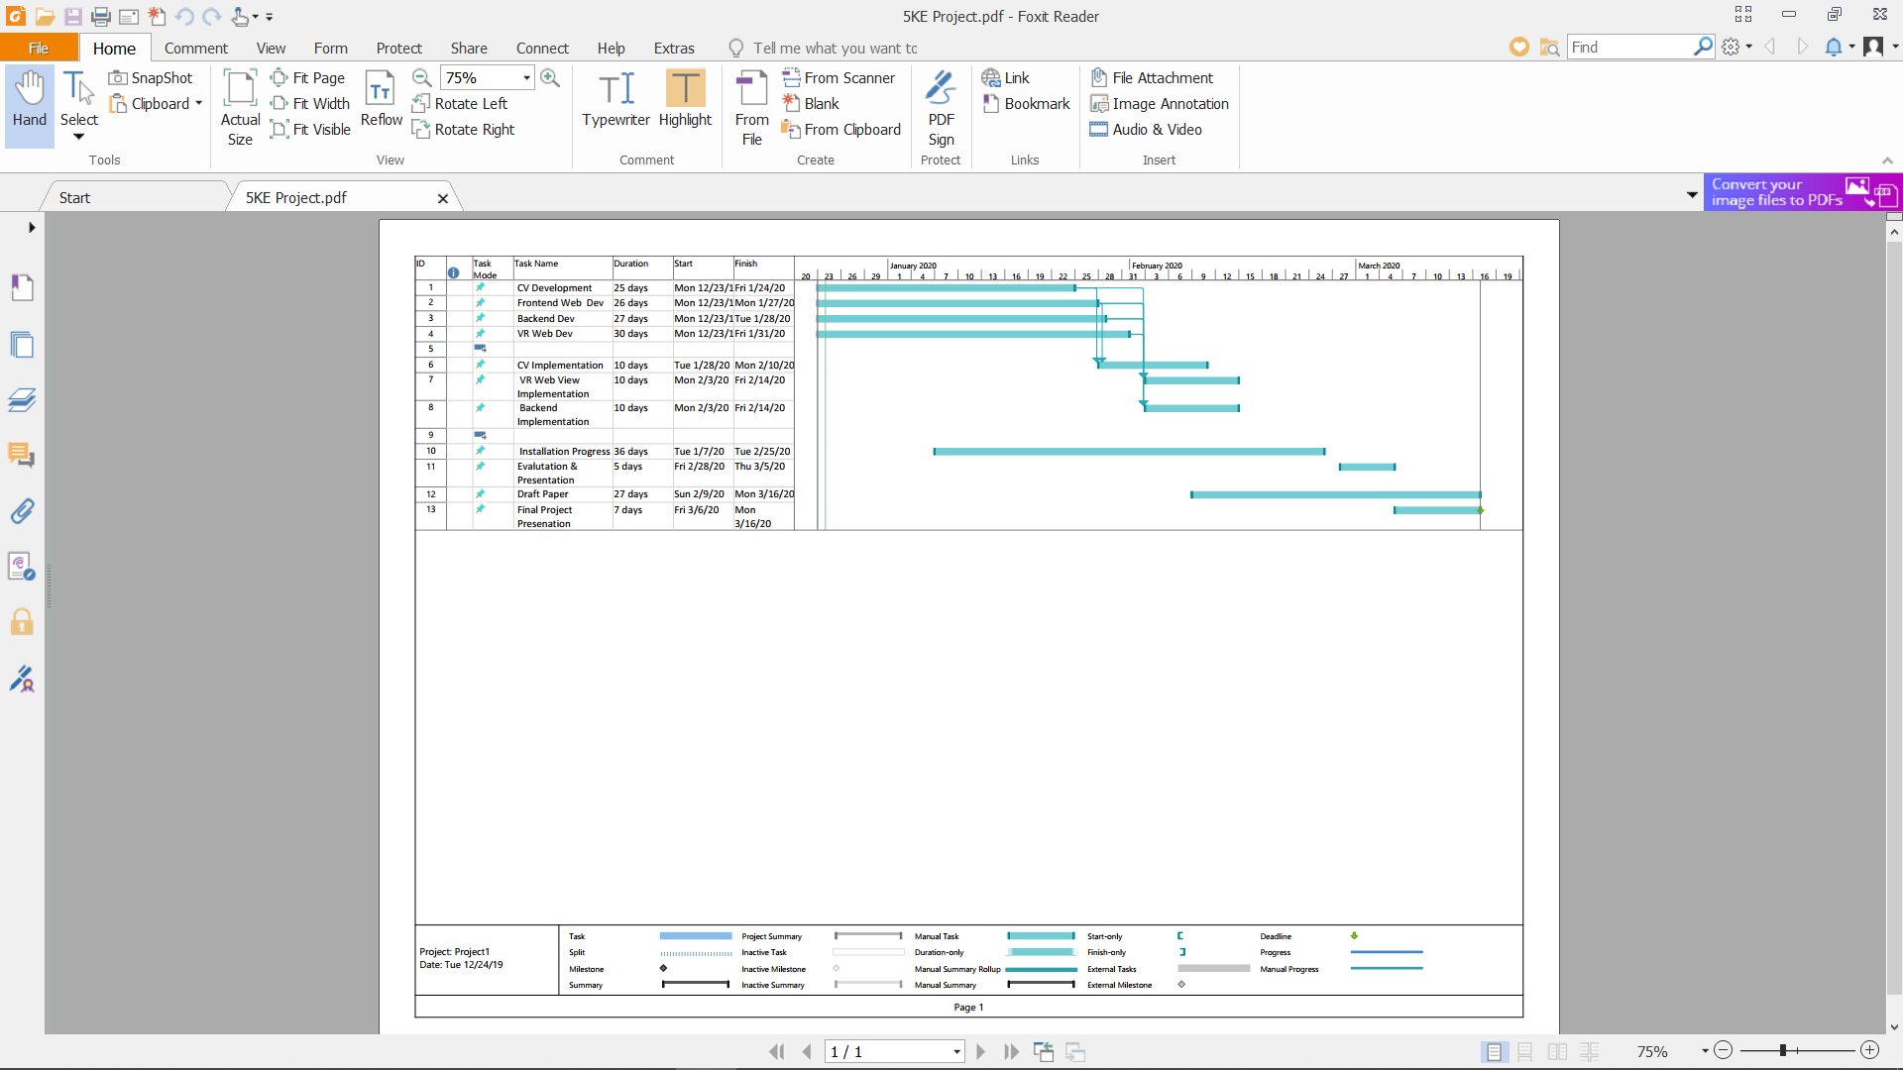
Project Timeline

Slide 8
Technology Details
Web Based Application
OpenCV
CV Algorithms
WebGL and Threejs

Slide 9
CV Concept
Original
Canny Edge
Segmentation
Result

Slide 10
VR WebGL Concept
Interior Visualization
Change Furniture Material
Object Material
Furniture Texture

Slide 11
System Design
Client
Website
Wall Paint Engine
3D Floorplan
Web VR

Slide 12





Background Theory
THE BIG THREE

Slide 13
Background Theory
Canny Edge Detection
Gaussian Smoothing
Dilating
Flood Filling
Alpha Blending

Slide 14
Canny Edge Detection
multi-step algorithm that can detect edges with noise supressed at the same time

Slide 15
Gaussian Smoothing
The Gaussian smoothing operator is a 2-D convolution operator that is used to `blur' images and remove detail and noise.
Similar to the mean filter, but it uses a different kernel that represents the shape of a Gaussian (`bell-shaped') hump. This kernel has some special properties which are detailed below.

Slide 16
Dilating
The most basic morphological operations are two: Erosion and Dilation. They have a wide array of uses, i.e. :
Removing noise
Isolation of individual elements and joining disparate elements in an image.

Slide 17
Flood Filling
Flood fill, also called seed fill, is an algorithm that determines the area connected to a given node in a multi-dimensional array. It is used in the "bucket" fill tool of paint programs to fill connected, similarly-colored areas with a different color, and in games such as Go and Minesweeper for determining which pieces are cleared.

Slide 18
Alpha Blending
the process of combining one image with a background to create the appearance of partial or full transparency. It is often useful to render picture elements (pixels) in separate passes or layers and then combine the resulting 2D images into a single, final image called the composite.

Slide 19
Background Theory
3D Modeling
Web VR Development
3D Floorplanner
Rendering Pipeline
WebGL

Slide 20
WebGL?
a JavaScript API for rendering interactive 2D and 3D graphics within any compatible web browser without the use of plug-ins.
WebGL is fully integrated with other web standards, allowing GPU-accelerated usage of physics and image processing and effects as part of the web page canvas.

Slide 21
WebGL Pros
Realtime rendering in browser
Tasks
Performance
Shaders

Slide 22
WebGL Pros
Tasks
It can perform tasks that are just not possible with other technologies – or, more accurately, would be difficult to accomplish (good luck producing complex lighting and reflective material effects in SVG!)

Slide 23
WebGL Pros
Performance
WebGL is blindingly fast and fully utilizes hardware acceleration, making it suitable for games or complex visualizations. Although other options can benefit from hardware acceleration, WebGL is written with performance in mind and should perform better than other options in many cases.

Slide 24
3D Modeling
-In 3D Modeling, the three main major theories are needed.
Visual Relativity
Perspective
Geometric

Slide 25
WebGL Pros
Shaders
WebGL applications can utilize mini programs known as “shaders” to produce complex visual effects. A simple shader might produce a sepia coloring effect, while a more complex implementation might simulate water or flames.

Slide 26
3D Modeling
Visual Relativity
The use of Visual Relativity in 3D modeling is using size, position and familiarity to create a spatial relationship pattern between two objects to define a space.
In Visual Relativity, all the components such as Color, Shape,size are important for brain to compare between two objects.

Slide 27
3D Modeling
Visual Relativity
Another trick of relativity is to use a interposition object.
This is an object that blocks the parts of another object.
In the sample with color added to it the extra cube blocks object B, while this new shape is blocked by object A..

Slide 28
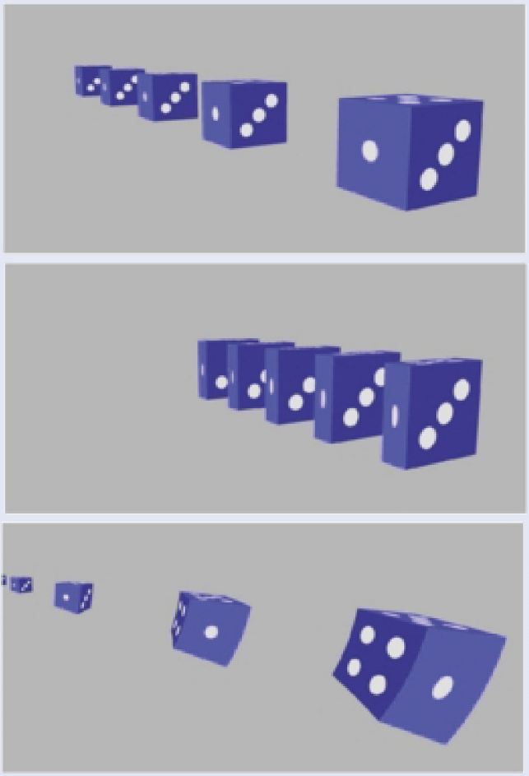
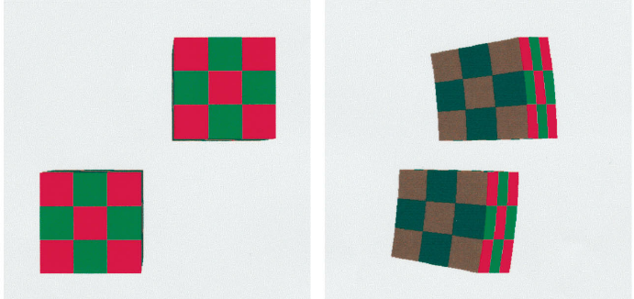
3D Modeling
Visual Relativity

Slide 29
3D Modeling
Perspective
Perspective can be used to manipulate what the viewer sees.
The closer the shape gets, the larger in the field of view it will be.

Slide 30
3D Modeling
Geometric
The basic object used in mesh modeling is a vertex, a point in three dimensional space.
Two vertices connected by a straight line become an edge. Three vertices, connected to each other by three edges, define a triangle, which is the simplest polygon in Virtual space.
More complex polygons can be created out of multiple triangles, or as a single object with more than 3 vertices. Four sided polygons and triangles are the most common shapes used in polygonal modeling.
A group of polygons, connected to each other by shared vertices, is generally referred to as an element. Each of the polygons making up an element is called a face.

Slide 31
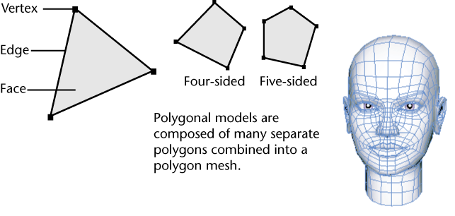
3D Modeling

Slide 32
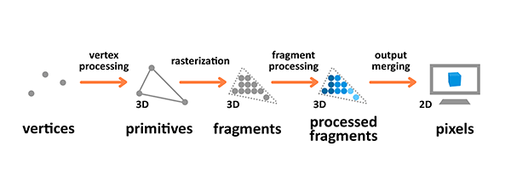
3D Modeling

Slide 33
Web VR and 3D Floorplanner
Basic Process
Developing the Web VR for visualization is quite challenging
Four Basic Process in threejs
Scene
Renderer
Camera
Adding Object

Slide 34
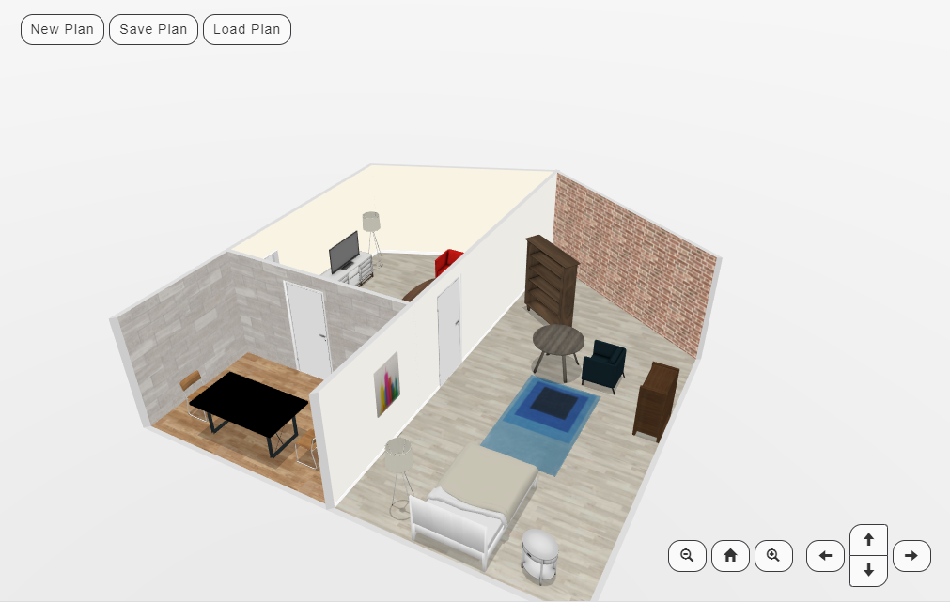
Web VR and 3D Floorplanner
3D Floorplanner view

Slide 35
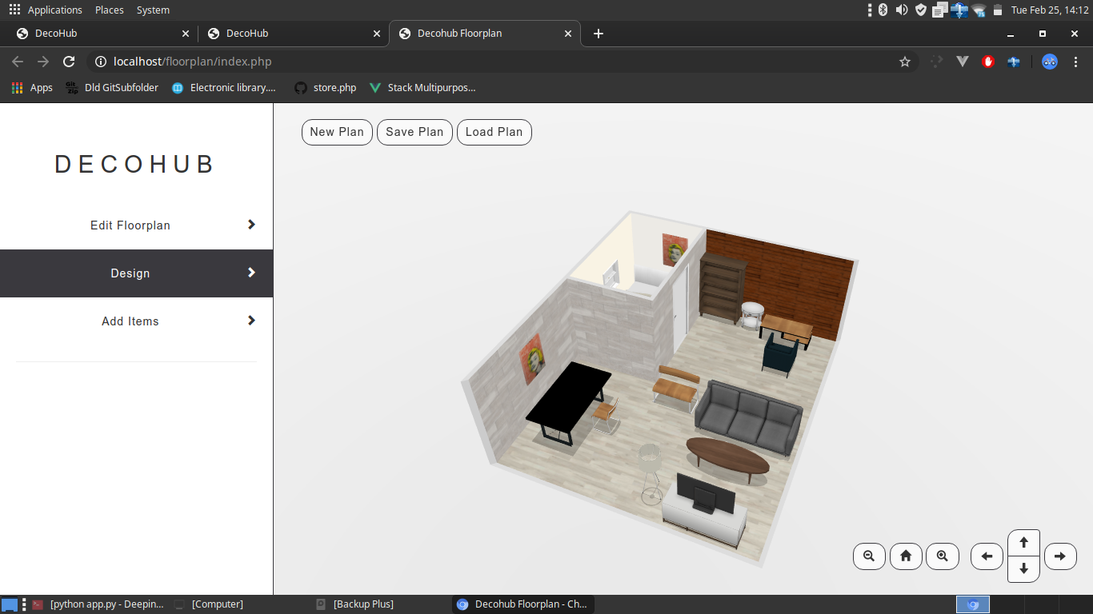
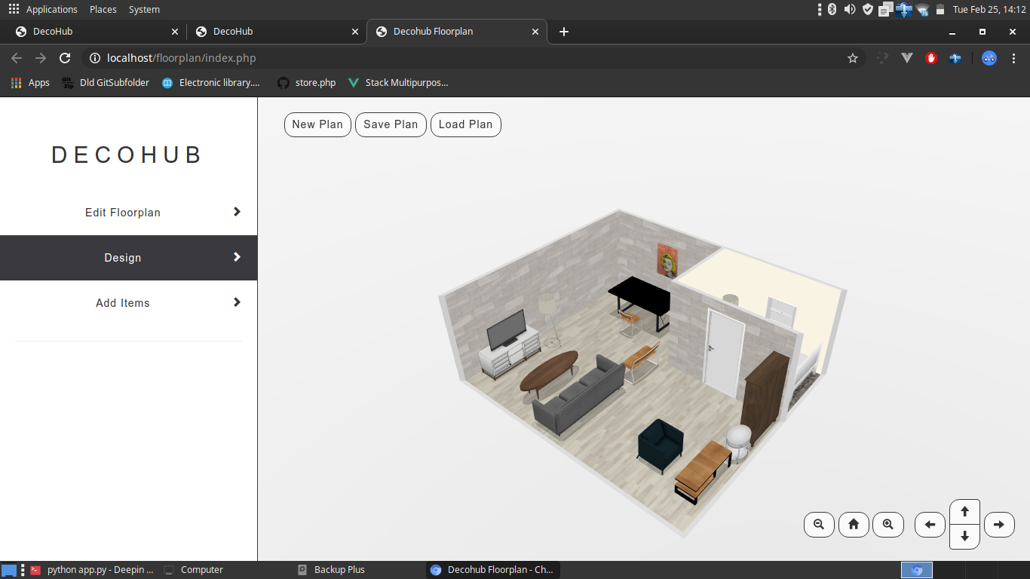
Web VR and 3D Floorplanner
3D Floorplanner view

Slide 36
Integration
Backend API Integration With Frontend
Backend Engine (Python + Flask)
PHP (Frontend)
SQLite
Flat File System for Processed Images

Slide 37
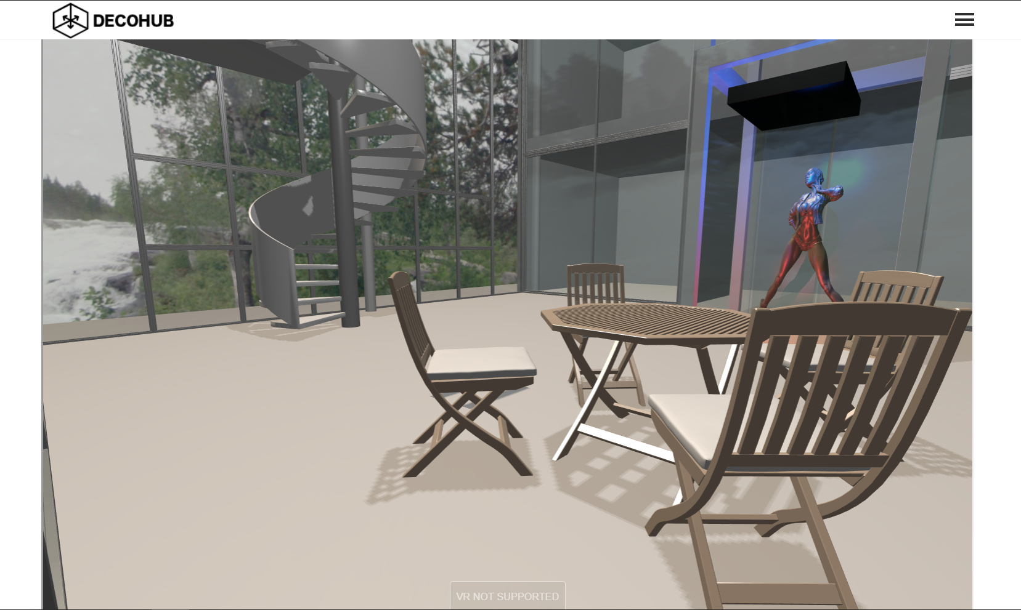
Final Result
WebVr

Slide 38
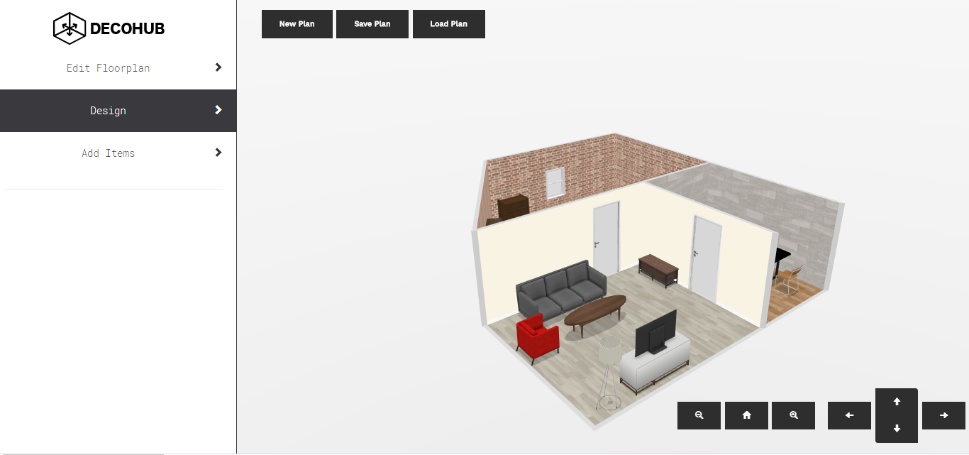
Final Result
3D Floor-Planner

Slide 39
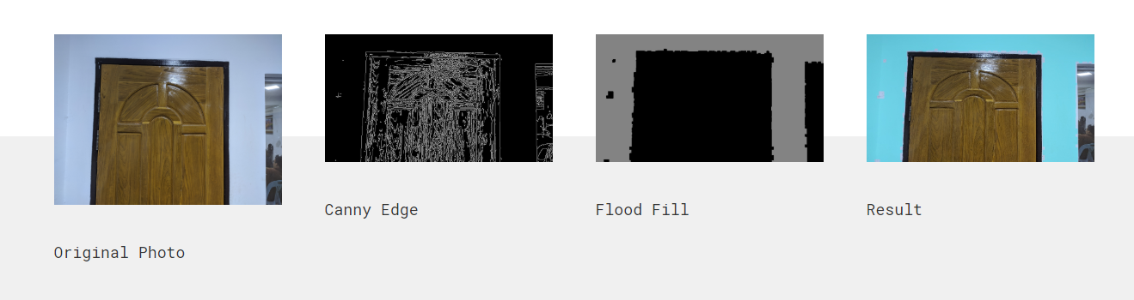
Final Result
Wall Paint Engine

Slide 40
Evaluation
CPU, GPU and memory usage
Time taken for VR room and floor planner (CPU Vs GPU)
Time taken for image processing (different methods)

Slide 41
Conclusion
Problems
Cannot Add Shaders in VR room
Cannot Add external Objects in Floorplanner
Noises in wall Painting
Further Development
Adding Postprocessing in VR room
Adding new objects in floorplanner
Remove noise and interactive seed point for flood fill

Slide 42
Thank You

